Slide 1


Scalable Management of Trajectories and Context Model Descriptions
Collaborative Research Center 627
Ralph Lange
PhD graduate (Dr. rer. nat.) of the Universität Stuttgart
Supervisor: Prof. Dr. Kurt Rothermel
Institute of Parallel and Distributed Systems (IPVS)

Slide 2
Motivation
Context-awareness and context-aware computing
Examples:
  Adapt ring volume to ambient noise
  Navigation of blind persons
➔ Advancements are closely connected to
➔ miniaturization of sensing, computing,
➔ and communication hardware
“
”
… the ability of a mobile user’s applications to discover and
react to changes in the environment they are situated in.
(Schilit and Theimer, 1994)

Slide 3
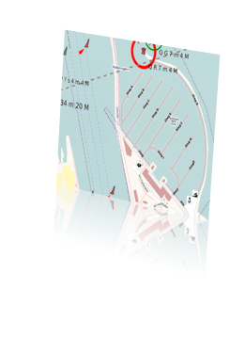
Motivation (2)
Proliferation of sensing technologies
  RFID, satellites, WSNs, smartphones, …
Comprehensive models of physical environment
  Differ in granularity, aspect, dynamism, …
➔ Huge potential for context-aware applications
  Ability to select context information
  from different providers
  Trend: Millions of context models shared
  by large number of applications
© OpenStreetMap contributors,
© CC BY-SA

Slide 4
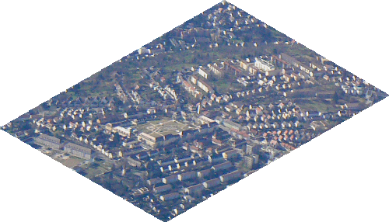
Problem Statement
?
How to provide efficient access to
the immense amounts of distributed
dynamic context information
Applications
Discovery service
for context models
MOD
1. Formal describing of context models
2. Indexing of context model descriptions
Large amounts of trajectory data
E.g. 3∙10⁷ GPS records per year
High communication cost
Huge storage consumption
3. Efficient real-time trajectory tracking
4. Distributed indexing of
4. space-partitioned trajectories
Notes:
Aerial photo taken by Ralph Lange.

Slide 5

Overview
Motivation and problem statement
Efficient real-time trajectory tracking
  Formal problem description
  Related work
  Generic Remote Trajectory Simplification (GRTS)
  Evaluation and conclusion
Distributed indexing of space-partitioned trajectories
Summary
Notes:
Pocket watch from Microsoft Cliparts.

Slide 6
Tracking: Formal Problem
Linear movements cause
redundant vertices
u₁
u₃
s₁
ε
s₂
Actual trajectory a(t) is function R → R^{d}
Sensed trajectory s(t) with vertices s₁, s₂, …, s_{C}
  … subject to inaccuracies
Simplified trajectory u(t) with vertices u₁, u₂, …
s₃
u₂
Definition: Efficient real-time trajectory tracking
  Goals: Minimize |(u₁, u₂, …)| and communication cost
  Simplification constraint: | u(t) – a(t) | ≤ ε ∀ t
  Real-time constraint: u(t) is available ∀ t ∈ [s₁.t,t_{C}]

Slide 7

Tracking: Related Work
Line simplification algorithms
  E.g. Douglas-Peucker heuristic
➔ High communication cost,
➔ no real-time behavior
Position tracking protocols
  Best mechanism: Dead Reckoning (DR)
➔ Linear DR with ½ε allows for trajectory
➔ tracking [Trajcevski et al. 2006]
l_{V}
l_{O}
ε
u_{j +1}=l_{O}
ε
ε
>ε
ε
ε
ε
l_{V}
u_{j}
l_{O}
Notes:
Globe from Microsoft Cliparts.

Slide 8
Tracking: GRTS
≈ε
Tracking and simplification
are different concerns
Basic approach of Generic Remote Trajectory Simplification
  DR to report latest movement
  Arbitrary line simplification algorithm for past movement
    Computational cost ↔ reduction efficiency
  ➔ Tracking and simplification must be synchronized!
u₁
≈ε
u₂
≈ε

Slide 9
Tracking: GRTS Protocol
Moving object
MOD
Sensing history S
Stable part
Variable part
Predicted part
DR causes update,
simplify history S
S
Stable part
Variable
part
Predic
part
Update
Reduce S …

Slide 10
Tracking: GRTS Variants
So far, not defined how to reduce S …
GRTS_{k} limits variable part to k line sections
  Unbounded computational costs
GRTS_{m} limits |S| to m
  Real-time guarantees regarding computing time
  Reduction rate is bounded by m
➔ Compress S if its size exceeds m
GRTS_{mc}
  Additional attribute s_{i}.δ for compressed positions
Stable part
Variable part
Predicted pa
Sensing history S

Slide 11
Tracking: Evaluation Setup
Evaluating different GRTS* realizations
  GRTS*^{Opt} – with optimal simplification algorithm [Imai and Iri 1988]
    Reduces simplification to shortest-path problem
  GRTS*^{Sec} – with online Section Heuristic [e.g. Meratnia and de By 2004]
Comparing GRTS* realizations to …
  Linear DR with ½ε (LDRH)
  Optimal offline simplification (Ref^{Opt})
  Douglas-Peucker algorithm (Ref^{DP})
Simulated with real GPS traces (> 330 h) from OpenStreetMap

Slide 12
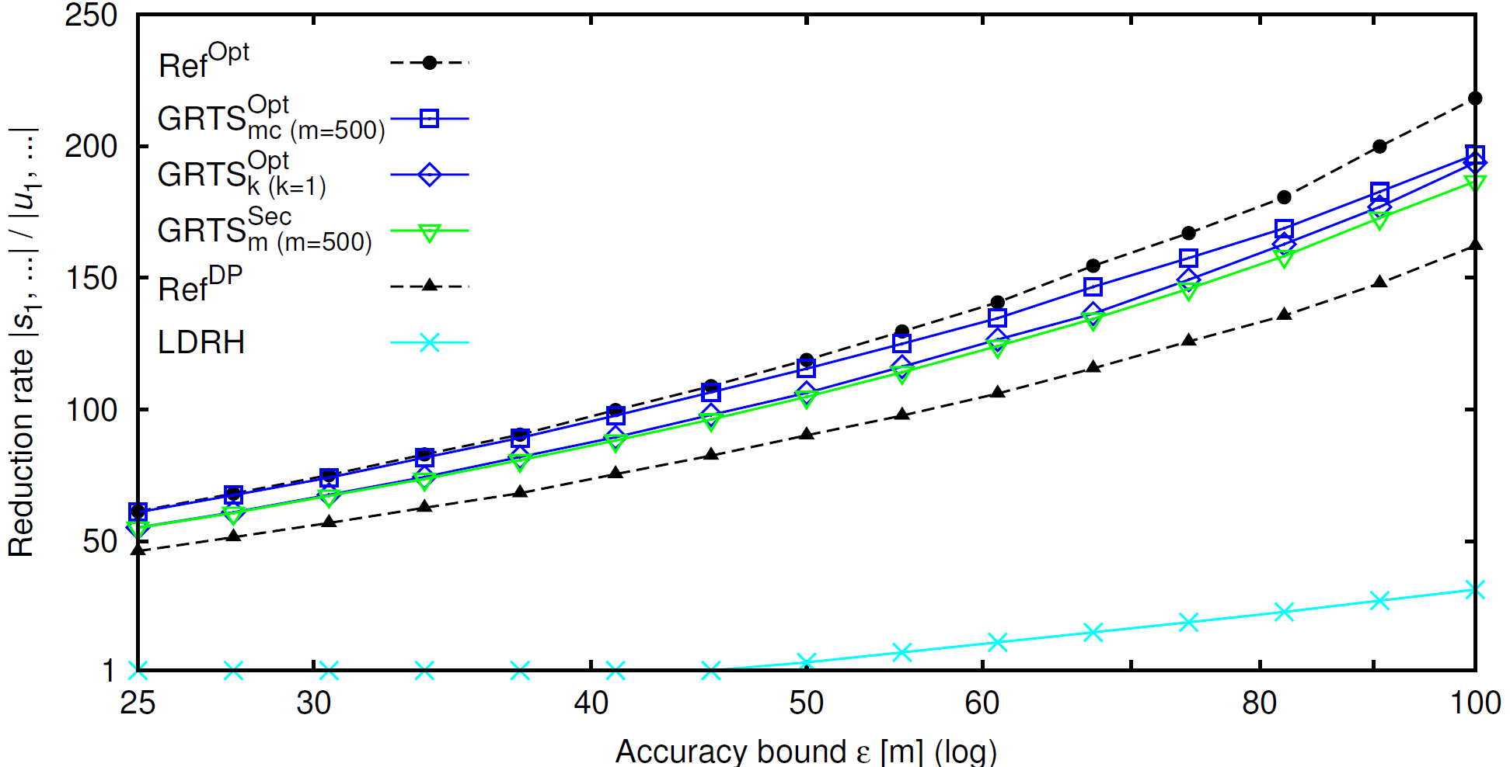
Tracking: Reduction Efficiency
GRTS*^{Opt} achieves up to 97%
of best possible reduction.
GRTS*^{Sec} achieves 85 to 90%
of best possible reduction.
All GRTS realizations outperform
offline simplification with Ref^{DP}

Slide 13
Tracking: Conclusion
LDRH
If communication cost
have maximum priority
CDR
CDR_{m}
GRTS_{k}^{Sec}
GRTS
GRTS_{k}
GRTS_{k}^{Opt}
Simple approach,
good reduction
GRTS_{m}^{Sec}
GRTS_{m}
GRTS_{m}^{Opt}
GRTS_{mc}^{Sec}
GRTS_{mc}
GRTS_{mc}^{Opt}
Best reduction, high
computational costs

Slide 14
Distributed Indexing of Trajectories
Managing large number of
mobile objects requires
distributed MOD
o₁
o₁
o₂
o₂
s₂
s₁
s₂
s₁
 | Spatial partitioning | Object-based partitioning
Update-aware distribution |  | –
Coordinate-based queries |  | –
Trajectory-based queries | ? | 
  Distributed Trajectory Index (DTI) creates temporal index (overlay)
  for routing queries to responsible servers efficiently
  Special support for aggregate queries by DTI+S

Slide 15
Summary
Applications
?
How to provide efficient access to
the immense amounts of distributed
dynamic context information
MOD
  1. GRTS and CDR for real-time trajectory tracking
  2. DTI for scalable distributed indexing of trajectories
  3. Formalism and SDC-Tree for describing and
  indexing of context models (see thesis)
Notes:
Aerial photo taken by Ralph Lange.

Slide 16
Thank you for your attention!
Selected publications in proceedings and journals:
Ralph Lange, Frank Dürr, Kurt Rothermel: “Efficient real-time trajectory tracking”. The VLDB Journal, 20(5):671-694, Oct 2011.
Ralph Lange, Frank Dürr, Kurt Rothermel: “Indexing Source Descriptions based on Defined Classes”. In: Proc. of 14th IDEAS. Montreal, QC, Canada. Aug 2010.
Ralph Lange, Frank Dürr, Kurt Rothermel : “Efficient Tracking of Moving Objects using Generic Remote Trajectory Simplification”. In: Proc. of 8th PerCom Workshops. Mannheim, Germany. Mar 2010.
Ralph Lange, Harald Weinschrott, Lars Geiger, André Blessing, Frank Dürr, Kurt Rothermel, Hinrich Schütze: “On a Generic Uncertainty Model for Position Information”. In: Proc. of 1st QuaCon. Stuttgart, Germany. Jun 2009.
Ralph Lange, Tobias Farrell, Frank Dürr, Kurt Rothermel: “Remote Real-Time Trajectory Simplification”. In: Proc. of 7th PerCom. Galveston, TX, USA. Mar 2009.
Ralph Lange, Frank Dürr, Kurt Rothermel: “Scalable Processing of Trajectory-Based Queries in Space-Partitioned Moving Objects Databases”. In: Proc. of 16th ACM GIS. Irvine, CA, USA. Nov 2008.
Ralph Lange, Frank Dürr, Kurt Rothermel: “Online Trajectory Data Reduction using Connection-preserving Dead Reckoning”. In: Proc. of 5th MobiQuitous. Dublin, Ireland. Jul 2008.
➔ See www.lange-ralph.de for complete list

