Slide 1
Scalable Processing of Trajectory-Based Queries in Space-Partitioned Moving Objects Databases
Ralph Lange, Frank Dürr, Kurt Rothermel
Institute of Parallel and Distributed Systems (IPVS) Universität Stuttgart, Germany
firstname.lastname@ipvs.uni-stuttgart.de

Slide 2
Outline
Motivation and problem
System model
Basic processing scheme
Distributed Trajectory Index (DTI)
Enhanced DTI using summaries (DTI+S)
Evaluation
Related work
Summary

Slide 3
Motivation and Problem
Space-partitioned moving objects databases
Enable scalable management of a large numbers of trajectories
Update-aware distribution of database servers
Query processing
Coordinate-based queries: “Which objects were located in R during [t₁,t₂]?”
➔ Spatial partitioning inherently enables efficient processing
Trajectory-based queries: “What distance covered object o₂ during [t₃,t₄]?”
➔ How to determine and route to relevant servers efficiently?
o₁
o₁
o₂
o₂
s₁
s₂

Slide 4
System Model
s₁
s₂
s₃
s₄
Moving objects o₁ to o_{m}
Trajectory of object o
Spatiotemporal polyline with vertices p₀, p₁, p₂, …
(p_{i}.x, p_{i}.y) denotes position at p_{i}.t
Trajectory segment simply can be specified by time interval
Servers s₁ to s_{n}
One server per service region
Store segments in their regions
Geographic overlay network
p₀
p₃
p₉
t_{e}
t_{s}
s₅
s₆
s₇
Trajectory-based query
Formal specification q_{type}(o,t_{s},t_{e})
Refers to trajectory segment [t_{s},t_{e}] of object o
type = segment, length, max-speed

Slide 5
Basic Processing Scheme
s₁
s₂
s₃
s₄
Client
Phases for processing a trajectory-based query
1. Access to queried trajectory
Home server scheme
Not in scope of this talk
2. Trajectory-based routing to t_{e} or t_{s} using linking pointers
3. Trajectory-based routing and processing from t_{e} to t_{s}
➔ Trajectory-based routing in 2nd and 3rd phase can take a lot of hops
Depends on time span to cover and trajectory route
p₂₁
f_{h}(o)
t_{s}
t_{e}
s₅
s₆
s₇

Slide 6
DTI: Distributed Trajectory Index
Idea: Speed up routing by pointers to temporally distant positions
DTI scheme
Creates skip list of DTI nodes and pointers for each trajectory
Routing greedily selects pointer that is temporally closest to target
Number of hops logarithmically depends on temporal routing distance
➔ DTI composes overlay network
0
4
2
1
3
s₁
s₂
s₃
4
s₄
0
DTI-based routing
2
Geographic routing
t_{a}
1
3
Basic network (IP, …)
s₅
s₆
s₇

Slide 7
DTI: Distributed Trajectory Index (2)
Idea: Speed up routing by pointers to temporally distant positions
Creation of new DTI node
Periodic triggering of creation process
Shadow object (SO) stores position (anchor) of latest DTI node
Enables creating backward pointer at lowest level
DTI pointer message to create other pointers recursively
0
4
2
1
3
s₁
s₂
s₃
4
s₄
0
SO
2
1
3
s₅
s₆
s₇

Slide 8
DTI+S: Enhanced DTI with Summaries
Idea: Speed up processing using aggregates on queried attributes
DTI+S stores summary for each segment spanned by a DTI pointer
Summary contains length and maximum speed
Stored with the DTI pointer, here only in backward direction
Usability of summary depends on query type and partial result
Example 1: Length query
t_{e}→4: 123 m ➔ 123 m
4→2: +1487 m ➔ 1610 m
2→1: +623 m ➔ 2233 m
1→t_{s}: +104 m ➔ 2337 m
Example 2: Max speed query
t_{e}→4: 9 m/s ➔ 9 m/s
4→2: 13 m/s ➔ 13 m/s
2→t_{s}: 14 m/s ➔ 14 m/s
s₁
s₂
s₃
t_{e}
s₄
0
4
2
1
3
t_{s}
0→2: Length = 1745 m
0→2: Max speed = 14 m/s
1→2: Length = 623 m 1→2: Max speed = 14 m/s
s₅
s₆
s₇

Slide 9
Evaluation: Setup
Discrete-event simulator for space-partitioned MODs
Performance metric: processing time per query
Including network latencies, disk I/O times, and CPU times
Simulation time
3⋅10⁷ s ≈ 1 year
Network of 1000 MOD servers
Overall service area of 9⋅10⁶ km² – approximately continental U.S.
Real network topology: AT&T internet backbone
Each server is connected to geographically closest router

Slide 10
Evaluation: Setup (2)
Local storage layout at each server
Layout of data file as with TB-tree or PA-tree
Table for DTI nodes and temporal index for each object (see paper)
Page size of 4 kB, seek time of 10 ms, and transfer rate of 30 MB/s
Moving objects
Mobility model of Z. J. Haas, 1997 (ZRP) with v_{max} = 10 m/s
Random behavior at small and large scale
Report position using linear dead reckoning with 10 m ➔ 1.9⋅10⁶ updates
Trajectory-based queries
Uniform mix of 10⁶ queries posed from 2⋅10⁷ s on
Notes:
Remark: The 10^6 queries include region-relation queries!

Slide 11
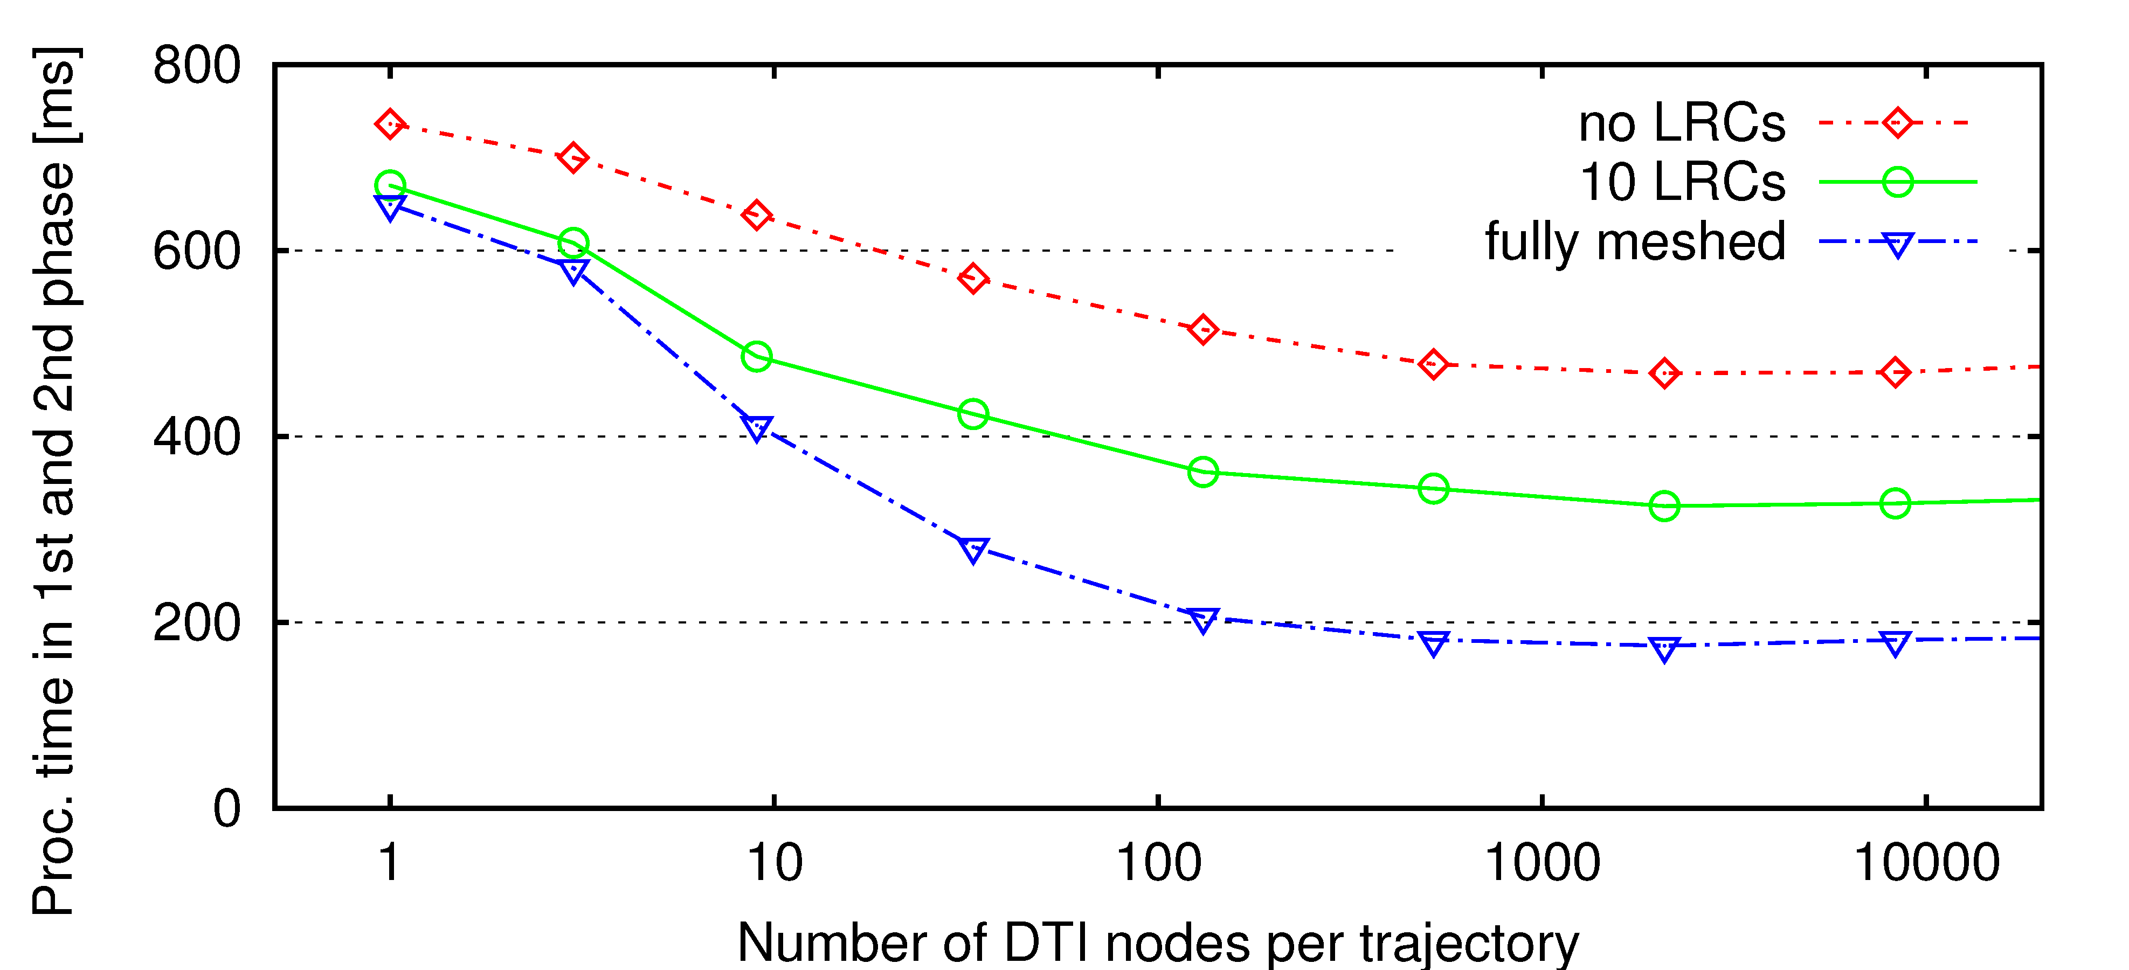
Routing Time against Number of DTI Nodes
Maximum savings for ≥ 2000 DTI nodes
In the following, one DTI node per hour – i.e. 8300 nodes in simulation time

Slide 12
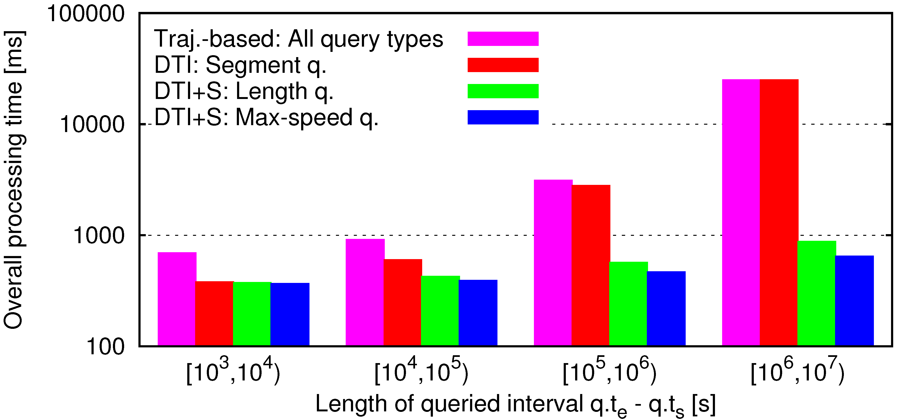
Processing Time against Queried Time
DTI+S reduces processing time up to 98%
Note: DTI+S accounts for less than 4.2% of the overall storage consumption

Slide 13
Related Work
Multitude of index structures for MODs
STR-tree, TB-tree, MVR-tree, SETI, BB^{x}-tree, PA-tree, …
➔ Not intended for distributed MODs
Location management systems
GSM location registers, Nexus location service, Geogrid, …
Base on spatial partitioning, particularly for update-aware distribution
➔ Do not store past positions
BORA: Distributed processing of range queries (Trajcevski et al. 2007)
Builds an aggregation tree using Bresenham’s line algorithm
➔ BORA and DTI+S together enable efficient processing of both query classes

Slide 14
Summary
Space-partitioned MODs allow for scalable management of trajectories
DTI scheme
Creates distributed temporal index for each trajectory
Enables efficient routing of queries along trajectories
DTI with summaries (DTI+S)
Additionally stores aggregates such as length and maximum speed
➔ DTI+S reduces processing time by more than an order of magnitude

Slide 15
Thank you for your attention!
Ralph Lange Institute of Parallel and Distributed Systems (IPVS) Universität Stuttgart
Universitätsstraße 38 · 70569 Stuttgart · Germany
ralph.lange@ipvs.uni-stuttgart.de · www.ipvs.uni-stuttgart.de

Slide 16
Backup Slides

Slide 17
Motivation and Problem
Moving objects databases (MODs)
Store and index trajectories of vehicles, containers, mobile devices, …
Coordinate-based queries: “Which objects were located in R during [t₁,t₂]?”
Trajectory-based queries: “What distance covered object o₂ during [t₃,t₄]?”
➔ Many application scenarios require partitioning the MOD
o₁
o₁
o₁
o₂
o₂
o₂
s₂
s₁
s₂
s₁
 | Spatial partitioning | ID-based partitioning
Update-aware distribution |  | –
Coordinate-based queries |  | –
Trajectory-based queries | ? | 
How to determine and route to relevant servers efficiently?

Slide 18
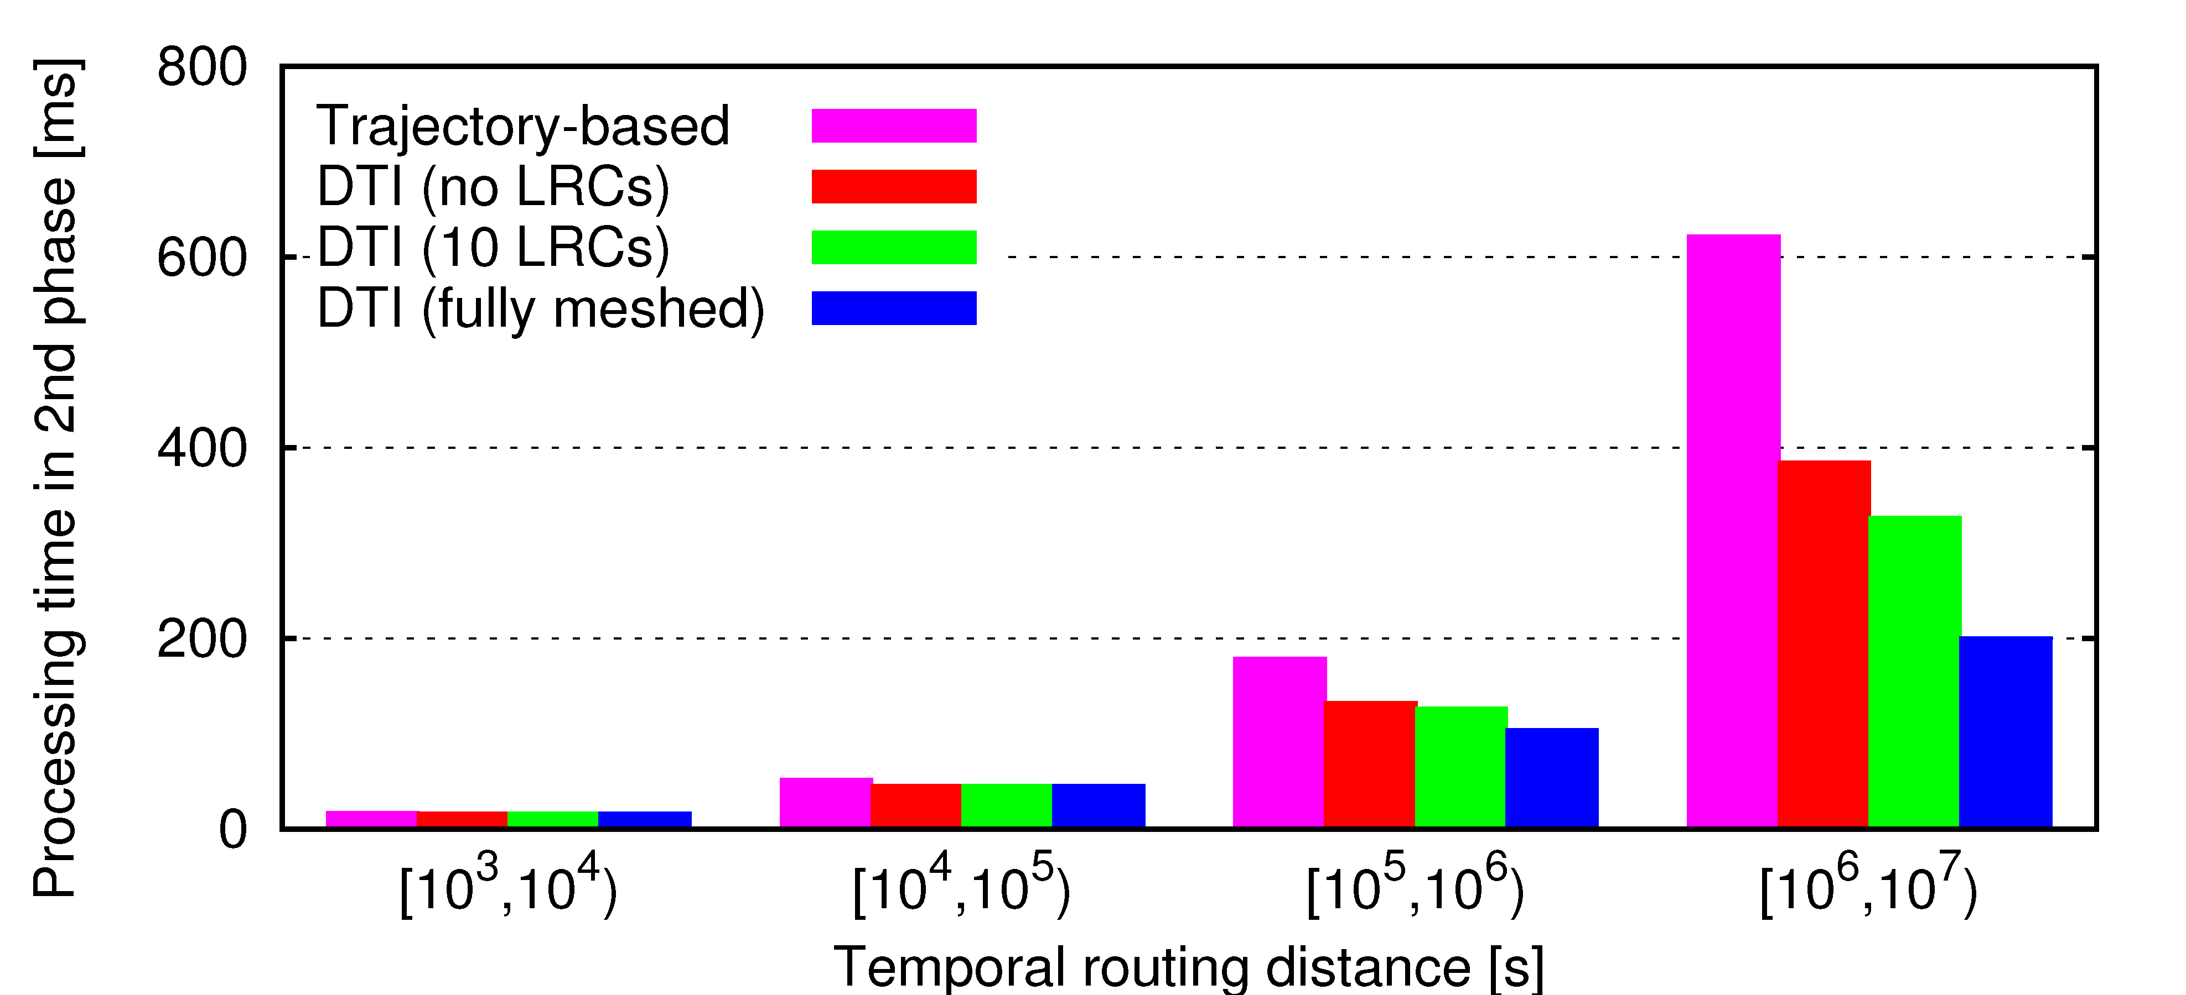
Routing Time against Routing Distance
Small routing times even if respective segment is partitioned to 700 servers
Trajectory-based routing also uses implicit shortcuts

