Slide 1
Remote Real-Time Trajectory Simplification
Universität Stuttgart
Institute of Parallel and Distributed Systems (IPVS)
Universitätsstraße 38 70569 Stuttgart, Germany
Collaborative Research Center 627
Ralph Lange, Tobias Farrell, Frank Dürr, Kurt Rothermel
Institute of Parallel and Distributed Systems (IPVS) Universität Stuttgart, Germany
firstname.lastname@ipvs.uni-stuttgart.de

Slide 2
Motivation
Importance of position data of moving objects
Variety of application scenarios
Primary context
Requirements of pervasive applications
Position tracking in real-time
Queries about large numbers of objects
Queries on past positions
!
Management and storage of trajectories

Slide 3
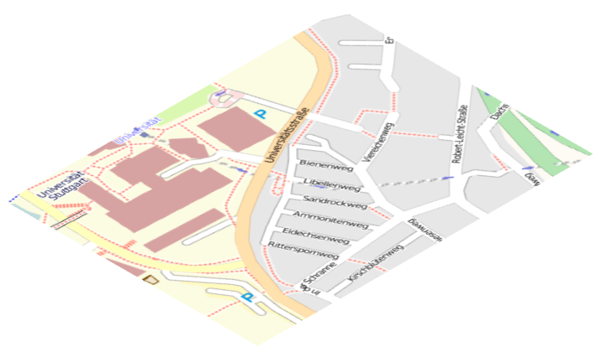
Moving Objects Databases
Applications
Queries
Results
MOD
Problem: Large amounts of trajectory data
GPS receiver generate 3∙10⁷ records per year
High communication cost
Consume a lot of storage capacity
High costs for query processing
Update messages
Object O₁
?
How to reduce trajectory data on the objects in real-time?
© OpenStreetMap contributors, © CC BY-SA

Slide 4
Outline
Formal problem statement
Related work
Generic Remote Trajectory Simplification (GRTS)
Basic algorithm
GRTS^{Opt}
GRTS^{Sec}
Evaluation
Summary

Slide 5
Formal problem statement
Kinds of trajectories
Actual: a(t) is function  → ^{d}
Sensed: s(t) with vertices s₁, s₂, …
Attribute s_{i}.p denotes position at time s_{i}.t
Simplified: u(t) with vertices u₁, u₂, …
u₃
ε
u₁
s₁
s₂
u₂
Remote Trajectory Simplification (RTS)
Optimize |(u₁, u₂, …)| and communication cost
Simplification constraint: | u(t) – a(t) | ≤ ε for all t
Real-time constraint: At current time t_{C}, position u(t) is available at MOD for t ∈ [s₁.t,t_{C}]

Slide 6
Related work
l_{V}
u_{j +1}=l_{O}
ε
l_{O}
RTS is related to …
Line simplification
Position tracking (dead reckoning)
ε
>ε
ε
ε
Existing RTS approaches
Linear dead reckoning with ½ε [Trajcevski et al. 2006]
Connection-preserving dead reckoning [Lange et al. 2008]
➔ Solely based on dead reckoning
l_{V}
u_{j}
l_{O}

Slide 7
Generic RTS
≈ε
Tracking and simplification are different concerns
Basic approach of GRTS
Latest movement is reported by linear dead reckoning (LDR)
Arbitrary line simplification algorithm for former movement
Computational cost ↔ reduction efficiency
u₁
≈ε
u₂
≈ε
!
Simplification and tracking need to be synchronized

Slide 8
GRTS algorithm
ε
s₁₃
s₁₄
ε
s₁₅
l_{O}
l_{V}
l_{V}
u₅=u_{m}
s₉
l_{O}
u₃
u₄
u₄=u_{m}
Sensing history
 = (s₉, …, s₁₃, s₁₄)
 = (s₉, …, s₁₃, s₁₄, s₁₅)
 = (s₁₃, s₁₄, s₁₅)
 = (s₉, …, s₁₃)
if LDR causes update then
' ← simplify  with bound ε – δ  ← ' \ (first('), last('))
(l_{O}, l_{V}) ← compute prediction … send update message (l_{O}, l_{V}, )
 ← ( s_{i} ∈  : s_{i}.t ≥ last().t )
end if
Simplification
' = (s₉, s₁₃, s₁₅)
 = (s₁₃) = (u₅)

Slide 9
GRTS^{Opt}
Optimal line simplification algorithm [Imai and Iri 1988]
Reduces simplification to shortest-path problem
u₅=u_{m}
u₃
u₄
u₄=u_{m}
Details of GRTS^{Opt}
Segmentation of  by LDR still influences reduction efficiency
Not same reduction like offline usage
If there exist multiple , use  with maximum last().t

Slide 10
GRTS^{Sec}
Section heuristic [e.g., Meratnia and de By 2004]
Simple, greedy online algorithm
u₅=u_{m}
>ε
u₃
u₄
u₄=u_{m}
Details of GRTS^{Sec}
Per-sense rather than per-update simplification
LDR does not influence simplification
Paper gives improved version of section heuristic

Slide 11
Evaluation: Setup
Comparing GRTS^{Opt} and GRTS^{Sec} to other RTS and offline algorithms
LDR with ½ε (LDR_{½})
Connection-preserving Dead Reckoning (CDR)
Optimal offline simplification (Ref^{Opt})
Douglas-Peucker algorithm (Ref^{DP})
Simulated with real GPS traces from the OpenStreetMap project
3 × 100 trajectories classified into foot, bicycle, and motor vehicle
See paper for details on means of transportation
More than 1.2 million sensed positions, i.e. > 330 h trajectory data

Slide 12
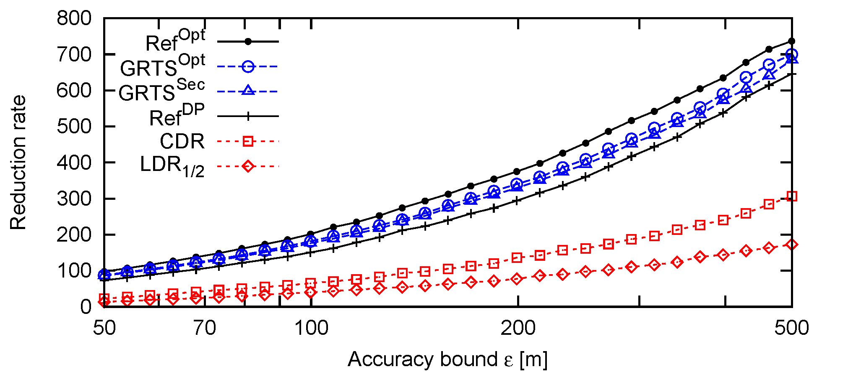
Evaluation: Reduction Rate
GRTS^{Opt} and GRTS^{Sec} outperform CDR by factor 2.9 and LDR_{½} by 5.2
GRTS^{Sec} is only 3% worse than GRTS^{Opt} and 12% worse than Ref^{Opt}

Slide 13
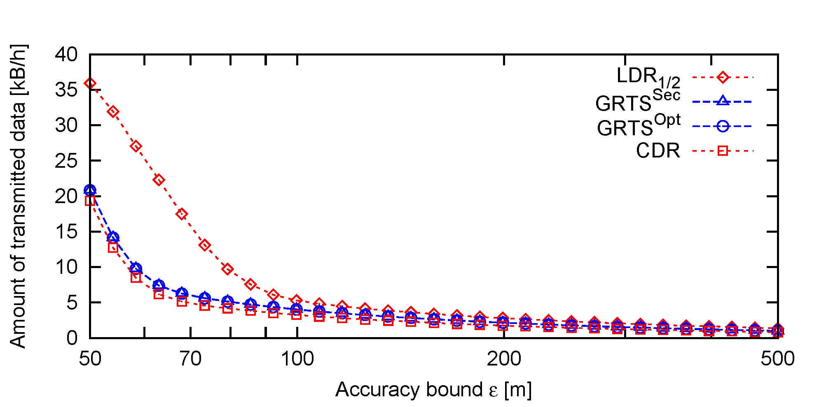
Evaluation: Communication
GRTS transmits less messages than CDR and only slightly more data
LDR_{½} transmits about twice as much data due to ½ε

Slide 14
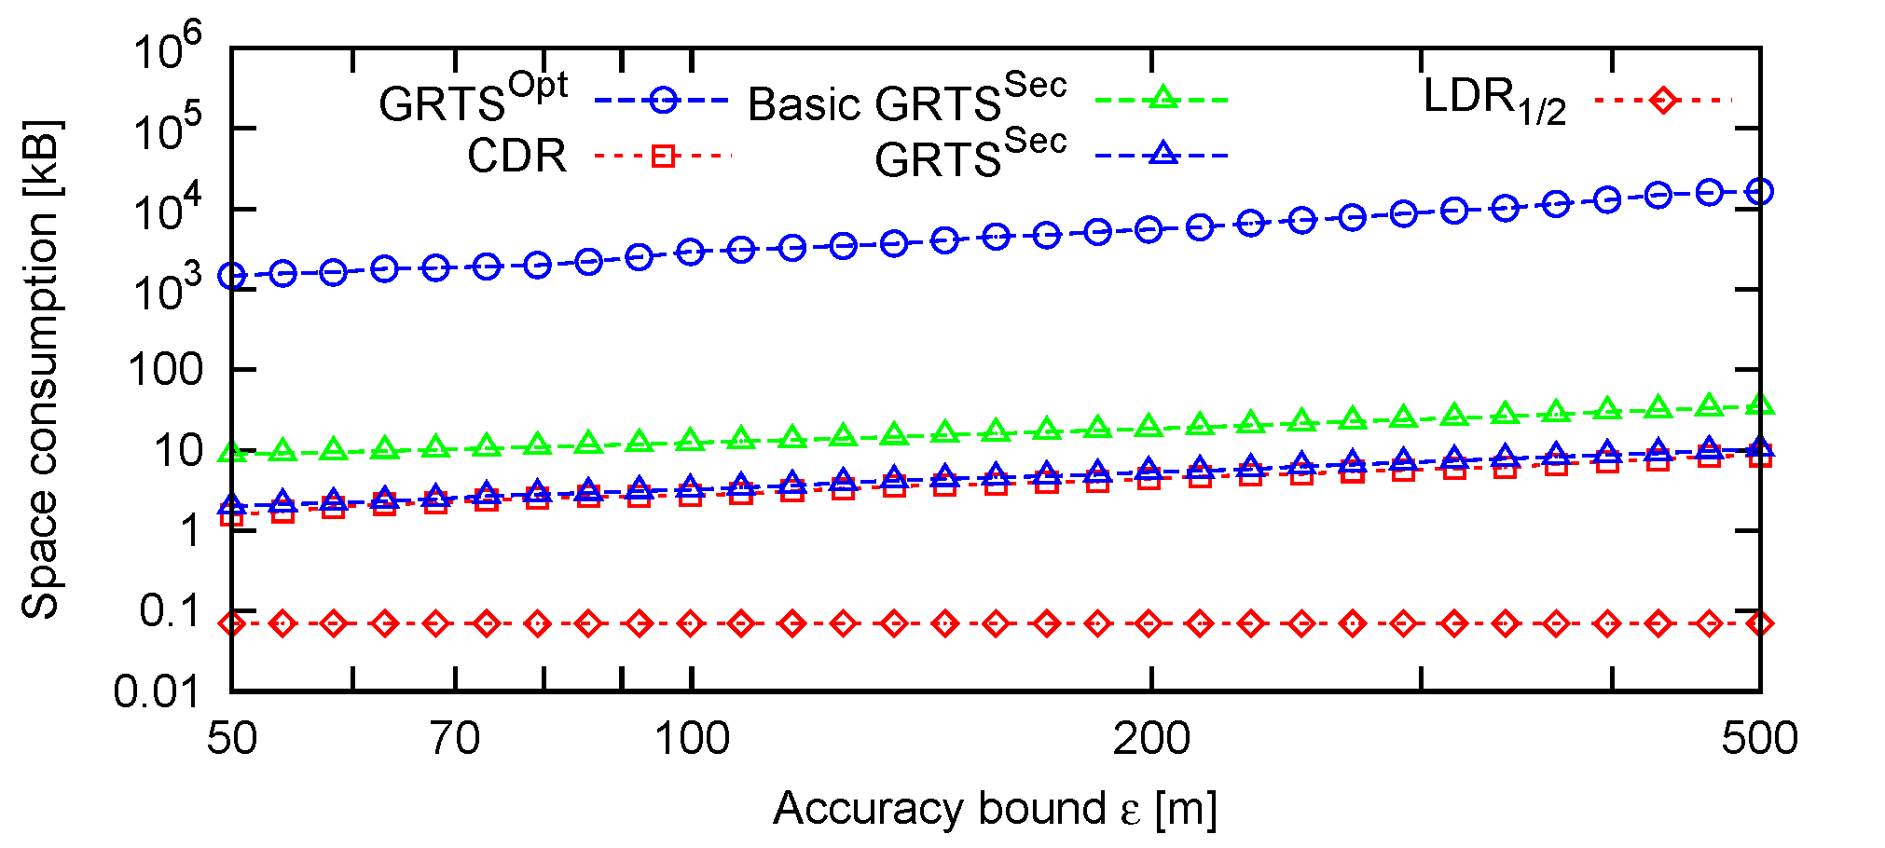
Evaluation: Space Consumption
Optimization of section heuristic reduces space consumption by > 70%
GRTS^{Opt} should be only preferred to GRTS^{Sec} on very powerful devices

Slide 15
GRTS-based Tracking System
➔ Experiments with prototypical tracking system confirm simulation results
Google Earth
KML File
Visualization
Requests
KML
Update Receiver
DB
HTTP Server
Server
Updates
Acks
GPS Unit
GRTS Alg
Update Sender
Mobile
GPS

Slide 16
Summary
Applications
Many pervasive applications rely on trajectory data
Moving objects databases store simplified trajectories
Save storage capacity
Optimize communication cost
Generic Remote Trajectory Simplification
Clearly separates tracking from simplification
Open to different line simplification algorithms
Only 12% worse than optimal offline simplification
MOD
© OpenStreetMap contributors, © CC BY-SA

Slide 17
Thank you for your attention!
Ralph Lange
Institute of Parallel and Distributed Systems (IPVS) Universität Stuttgart
Universitätsstraße 38 · 70569 Stuttgart · Germany ralph.lange@ipvs.uni-stuttgart.de · www.ipvs.uni-stuttgart.de

