Slide 1


Indexing Source Descriptions based on Defined Classes
Universität Stuttgart
Institute of Parallel and
Distributed Systems (IPVS)
Universitätsstraße 38
70569 Stuttgart, Germany
Collaborative Research Center 627
Ralph Lange, Frank Dürr, Kurt Rothermel
Institute of Parallel and Distributed Systems (IPVS)
Universität Stuttgart, Germany
firstname.lastname@ipvs.uni-stuttgart.de

Slide 2

Motivation
Heterogeneous information systems (HIS)
  Areas: logistics, finance, context management, …
  Types: FDBMS, mediator-based IS, PDMS
Problem: Source discovery in large HIS
  Schema mappings give coarse descriptions only
  1. Formalism for concise source descriptions
  2. Index structure for their efficient retrieval
Focus: Ontology-based HIS
SELECT … FROM
Which entities are
described by a source?
Which information is
given about the entities?
Notes:
Handheld from Microsoft Cliparts.
Earth from Microsoft Cliparts.

Slide 3
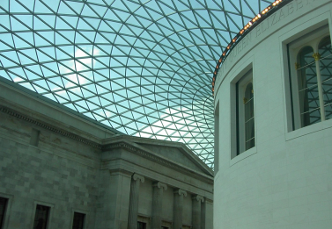
Motivation (2)
Example: Scalable Context Management (e.g. Nexus)
  Millions of providers of sensor data maps,
  3D building models, street maps, …
Well-known idea: Exclude sources from processing a query
using constraints
Contributions
  1. Advanced description formalism based on defined classes
    Alternative descriptions, constraints on relations, …
  2. Adjustable matching semantics
  3. Source Description Class Tree (SDC-Tree)
location = 44 Gt Russell St, London, UK
✗
location = Berlin, Germany
✓
?
name = “Pergamon Museum”
Notes:
Photo by Ralph Lange.

Slide 4

Overview
Motivation
Description formalism
Matching
Source Description Class Tree (SDC-Tree)
Evaluation
Summary
Notes:
Pocket watch from Microsoft Cliparts.

Slide 5
Describing Sources
Assumption: (simple) shared ontology
  Classes C_{i} , attributes a_{j} , relations r_{k}
Sources provide information about
coherent clippings of domain of discourse
  Entities share characteristic properties, which
  can be characterized by a defined class
  Recursive resolving of relations
  Differentiation of alternative defined classes – requires expert knowledge
D₁ = 〈BuildingPart : location ∈ {44 Gt Russell St, London, UK}〉
D₂ = 〈BuildingPart : partOf ∈ 〈Museum : name ∈ {“British Museum”}〉 〉
Notes:
Photo by Ralph Lange.

Slide 6
Definition of Defined Classes
Formal definition:
  Base(D) returns C
  isCon_{ai}(D) returns whether D has a constraint on a_{i}
  Con_{ai}(D) returns the constraint range for a_{i}
    … i.e. Con_{ai}(D) = X_{i} ⊆ Rng(a_{i})
  Of course, Dom(a_{i}) ≽ C
➔ Expressive and self-contained
D = 〈C : a₁ ∈ X₁ ⋀ a₂ ∈ X₂ ⋀ … ⋀ r₁ ∈ D₁ ⋀ r₂ ∈ D₂ ⋀ … 〉
same for relations r_{j}

Slide 7
Matching against Queries
Queries consist of only one defined class
➔ Possible matching semantics:
Example with query class Q and source description {D₁, …, D_{n}}
Positive: Overlapping constraints
matching indicator – like keywords
Negative: Exclusion of sources by disjoint
ranges of corresponding constraints
D₁ = 〈BuildingPart : location ∈ {44 Gt Russell St, London, UK}〉
D₂ = 〈BuildingPart : partOf ∈ 〈Museum : name ∈ {“British Museum”}〉 〉
✓
Q = 〈ExhibitionHall : location ∈ {44 Gt Russell St, London, UK}
⋀ partOf ∈ 〈Museum : name ∈ {“British Museum”}〉 〉
✓
Q = 〈ExhibitionHall : partOf ∈ 〈Museum : name ∈ {“Brit*”}〉 〉
✗
Q = 〈ExhibitionHall : location ∈ {London, UK} ⋀ partOf ∈ 〈Museum : name ∈ {“Churchill Mus*”}〉 〉

Slide 8
Matching against Queries
Necessary condition
for matching: ⇝_{Q}
Queries consist of only one defined class
➔ Possible matching semantics:
Example with query class Q and source description {D₁, …, D_{n}}
Positive: Overlapping constraints
matching indicator – like keywords
Negative: Exclusion of sources by disjoint
ranges of corresponding constraints
Disjoint ranges form sufficient
condition for dismatching: //_{Q}
D₁ = 〈BuildingPart : location ∈ {44 Gt Russell St, London, UK}〉
✗
?
Q = 〈ExhibitionHall : partOf ∈ 〈Museum : name ∈ {“Brit*”}〉 〉
✓
Q = 〈ExhibitionHall : location ∈ * ⋀ partOf ∈ 〈Museum : name ∈ {“Brit*”}〉 〉

Slide 9
Predicates
Query matching predicate
Source class D matches query class Q, denoted by D ⇝_{Q} Q, iff
  1. (Base(D) ≽ Base(Q)) ⋁ (Base(D) ≼ Base(Q))
  2. ∀ attribute a with (Dom(a) ≽ Base(Q)) ⋀ (Dom(a) ≽ Base(D)):
  isCon_{a}(D) ⇒ (isCon_{a}(Q) ⋀ (Con_{a}(D) ⋂ Con_{a}(Q) ≠ {}))
  3. ∀ relation r with (Dom(r) ≽ Base(Q)) ⋀ (Dom(r) ≽ Base(D)):
  isCon_{r}(D) ⇒ (isCon_{r}(Q) ⋀ (Con_{r}(D) ⇝_{Q} Con_{r}(Q)))
Visually: D and Q each span a cuboid
  Q must have same or more dimensions than D
  … and cuboids must overlap
Q
D

Slide 10
Predicates (2)
Query dismatching predicate
Source class D dismatches query class Q, denoted by D //_{Q} Q, iff
  ∃ attribute a with (Dom(a) ≽ Base(Q)) ⋀ (Dom(a) ≽ Base(D)):
  isCon_{a}(D) ⋀ isCon_{a}(Q) ⋀ (Con_{a}(D) ⋂ Con_{a}(Q) = {})
  or
  ∃ relation r with (Dom(r) ≽ Base(Q)) ⋀ (Dom(r) ≽ Base(D)):
  isCon_{r}(D) ⋀ isCon_{r}(Q) ⋀ (Con_{r}(D) //_{Q} Con_{r}(Q))
Matching
Source description {D₁, …, D_{n}} matches query class Q, iff
  1. ∃ D_{i} : D_{i} ⇝_{Q} Q
  2. ∄ D_{i} : D_{i} //_{Q} Q

Slide 11
Predicates (3)
Query subsumption predicate
Defined class D subsumes defined class Q, denoted by D ≽_{Q} Q, iff
  1. Base(D) ≽ Base(Q)
  2. ∀ attribute a with Dom(a) ≽ Base(D):
  isCon_{a}(D) ⇒ (isCon_{a}(Q) ⋀ (Con_{a}(D) ⊇ Con_{a}(Q)))
  3. ∀ relation r with (Dom(r) ≽ Base(D):
  isCon_{r}(D) ⇒ (isCon_{r}(Q) ⋀ (Con_{r}(D) ≽_{Q} Con_{r}(Q)))
Visually: Q must have same or more dimensions than D
… and Q has be to contained in D (in the dimensions of D)
Predicate ≽_{Q} is transitive
by construction since ≽
and ⊇ are transitive
Q
D

Slide 12
SDC-Tree
Large HIS require index structure for
efficient search of source descriptions
Defined classes may differ in three aspects:
  Base class
  Existence of constraints
  Ranges of constraints
Source Description Class Tree
  Indexes descriptions by source classes
  Split types for all differentiating aspects
Notes:
Handheld from Microsoft Cliparts.
Earth from Microsoft Cliparts.

Slide 13
SDC-Tree (2)
〈Thing, True : 〉
〈 BuildingPart : loc. ∈ [7,8]×[11,10] 〉
〈 BuildingPart : loc. ∈ [7,8]×[11,10] 〉
〈 BuildingPart : loc. ∈ [6,7]×[9,11] 〉
Nodes associated with node classes N_{i}
  Hierarchy by index subsumption
  predicate ≽_{I} , implying ≽_{Q}
  Base split
  Existence split
  Range split
D is indexed at leaf nodes where N_{i} ⇝_{I} D
  Index matching predicate ⇝_{I} implies ⇝_{Q}
Queries are passed by ⇝_{Q}
  Post-filtering for //_{Q}
〈Thing, False : 〉
〈LegalBody, True : 〉
Splits can be also performed by nested classes, e.g.
〈BuildingPart : partOf ∈ 〈Museum : name ∈ {[A*,Z*]}〉 〉
〈 BuildingPart : loc. ∈ [7,8]×[11,10] 〉
〈Spatial, True : 〉
〈Spatial, True : loc. ∈ NULL〉
〈Spatial, True : loc. ∈ [-90,-180]×[90,180] 〉
〈Spatial, True : loc. ∈ [-90,-180]×[0,180] 〉
〈Spatial, True : loc. ∈ [0,-180]×[90,180] 〉

Slide 14
SDC-Tree (2)
〈Thing, True : 〉
Implications between predicates:
  Extensions for node classes are
  evaluated by ⇝_{I} and ≽_{I} only
Completeness of indexing
  If D ⇝_{Q} Q, then ∃ path N₁, …, N_{k} :
  See paper for proof
≽_{Q}
⇒
⇝_{Q}
⇒
not //_{Q}
〈Thing, False : 〉
〈LegalBody, True : 〉
⇒
⇒
〈Spatial, True : 〉
≽_{I}
⇒
⇝_{I}
〈Spatial, True : loc. ∈ NULL〉
〈Spatial, True : loc. ∈ [-90,-180]×[90,180] 〉
∀ N_{i} : (N_{i} ⇝_{I} D) ∧ (N_{i} ⇝_{Q} Q)
〈Spatial, True : loc. ∈ [-90,-180]×[0,180] 〉
〈Spatial, True : loc. ∈ [0,-180]×[90,180] 〉

Slide 15
Split Algorithm
Actual structure of SDC-Tree depends on split operations
  Different split strategies are feasible
Generic split algorithm (GSAlg)
  Triggered by overflow of leaf node (n_{split})
  1. Compute all possible splits
    Recursive operation for nested classes
    Adapted partitioning algorithm of R*-Tree for range splits
  2. Rate each split from 1 (good) to 0 (bad)
    … depending on distribution of entries to potential child nodes
  3. Apply split with highest rating

Slide 16
Evaluation Setup
Implemented Simple Ontology Language (SOL)
  Attribute types with concrete domains and interval/set algebras
Implemented SDC-Tree as main memory index with GSAlg
Created spatial context ontology (see paper)
  Inspired by ADL Feature Types, SUMO, and PROTON
Created templates for source classes for typical spatial context providers
  E.g. building parts of a public building
  or streets and regions of a city
  Generated 1.1 · 10⁶ source classes using OpenStreetMap database
n_{split} = 10 (see paper)

Slide 17
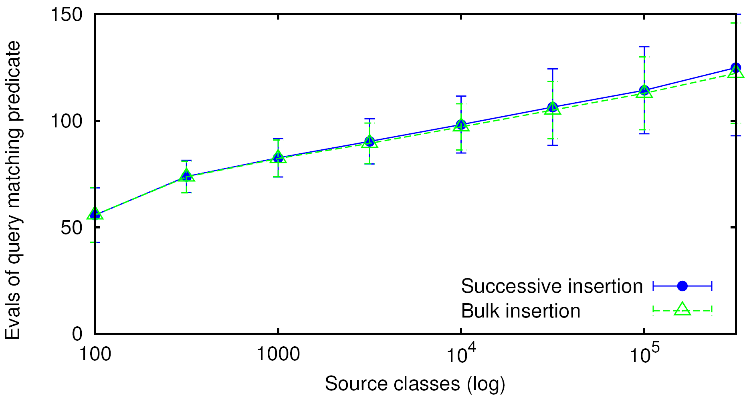
Results on Searching
Bulk insertion outperforms
successive insertion by ≈ 1%
Logarithmic search cost from
≈ 1000 source classes on

Slide 18
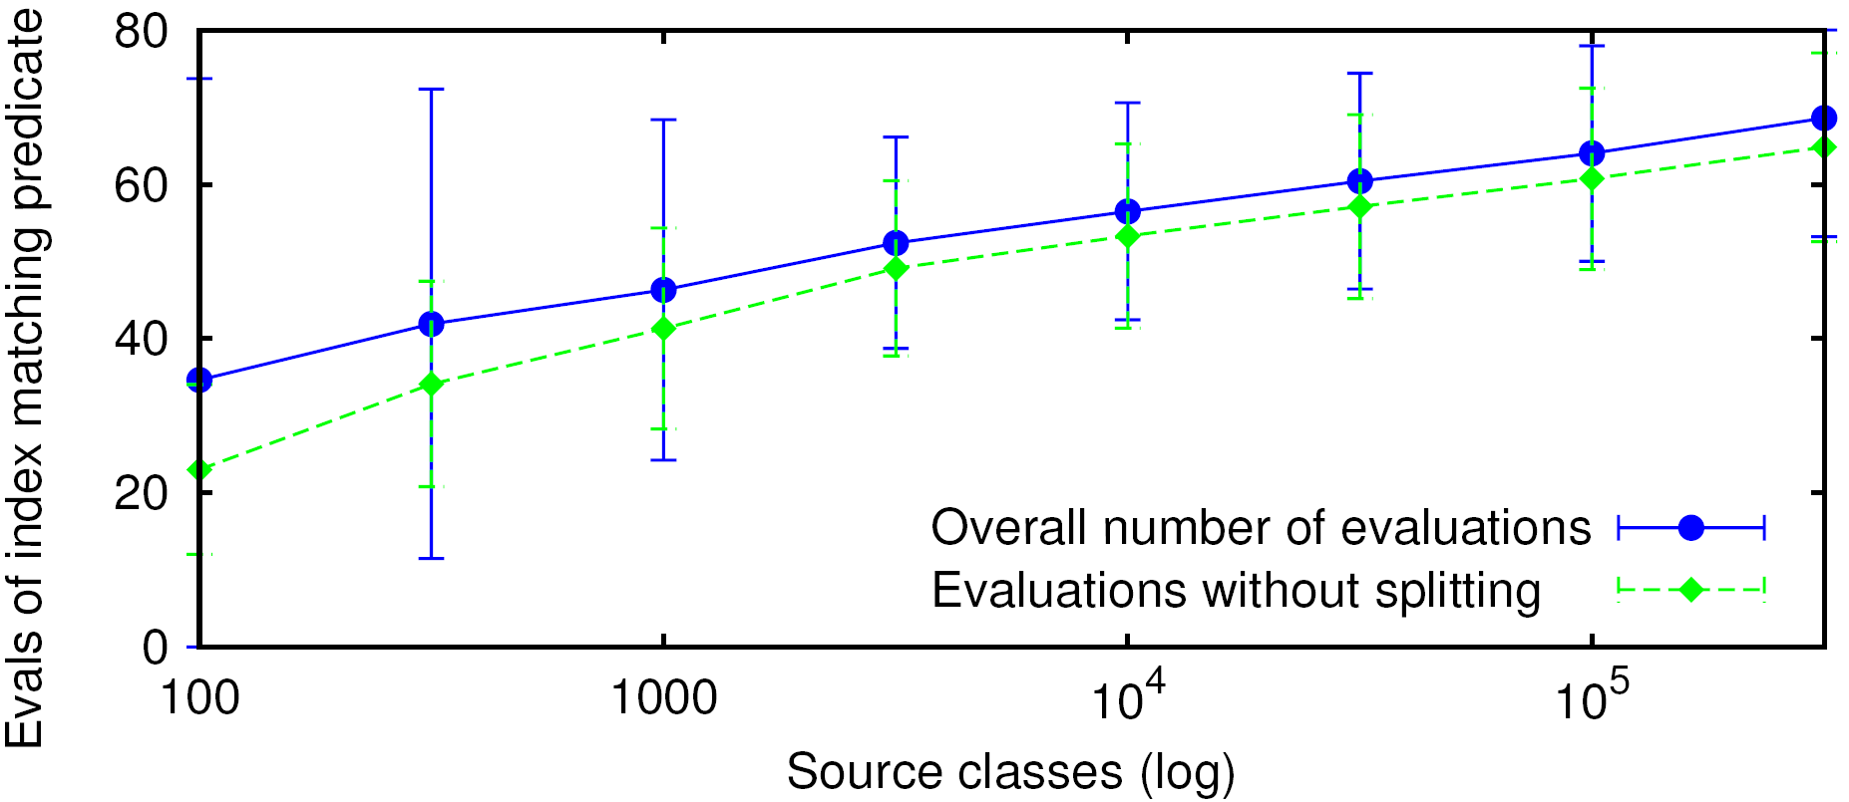
Results on Insertion
Cost for splitting amount
to ≈ 4 evaluations of ⇝_{I}
Conclusion: Logarithmic cost for search and insertion
  … despite heterogeneity of split types and predicates

Slide 19
Related Work
Integration systems (Information Manifold, Infomaster, Quete, …)
  Query processing excludes sources with unrelated attributes/relations
  Possible to enhance mappings by constraints (e.g. price > 20000)
➔ Not sufficient for large HIS
Discovery services for text sources (GlOSS, …)
  Keyword-based search and ranking
➔ Do not incorporate underlying ontology
P2P discovery services for ontology-based HIS (SCS, GloServ, …)
  Organize sources according to class hierarchy and selected attributes
➔ Large HIS require higher expressiveness and flexibility

Slide 20
Summary
Source discovery in large HIS requires specific approach
Proposed advanced description formalism for ontology-based HIS
  Based on nested defined classes
  Adjustable matching semantics using pseudo constraints
Source Description Class Tree (SDC-Tree) for efficient matching
  Extended defined classes to reflect three different split types
  Generic split algorithm for arbitrary ontologies
  Logarithmic search/matching cost
Which entities are
described by a source?
Which information is
given about the entities?

Slide 21
Thank you for your attention!
Ralph Lange
Institute of Parallel and Distributed Systems (IPVS)
Universität Stuttgart
Universitätsstraße 38 · 70569 Stuttgart · Germany
ralph.lange@ipvs.uni-stuttgart.de · www.ipvs.uni-stuttgart.de
Notes:
Question mark from Microsoft Cliparts.

Slide 22
BACKUP SLIDES

Slide 23
Assumptions for shared ontology
Classes {C₁, C₂, …} such as Building, BuildingPart, and ExhibitionHall
  Prnt(C_{i}) gives parent class of C_{i}
  C_{i} is subclass of C_{j} denoted by C_{i} ≺ C_{j}
Relations {r₁, r₂, …} such as ownedBy
  Dom(r_{i}) = C_{j} gives domain
  Rng(r_{i}) = C_{k} gives range, where possibly C_{j} = C_{k}
Attributes {a₁, a₂, …} such as name and location
  Dom(a_{i}) = C_{j} gives domain
  Rng(a_{i}) gives range like integer, string, ℝ², {“N”, “E”, “S”, “W”}, and [0,99]
➔ Compatible with prevalent ontology languages (e.g., OWL)

Slide 24
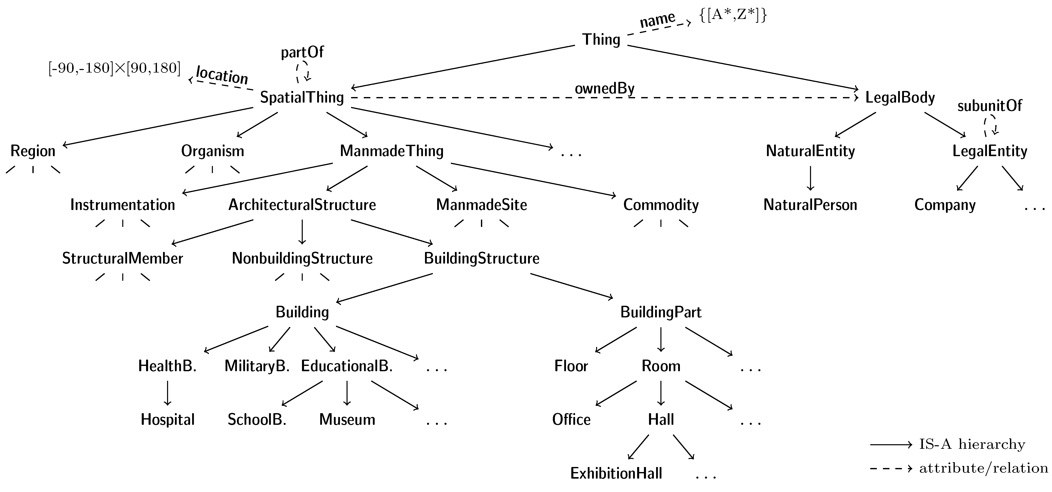
Spatial Context Ontology

Slide 25
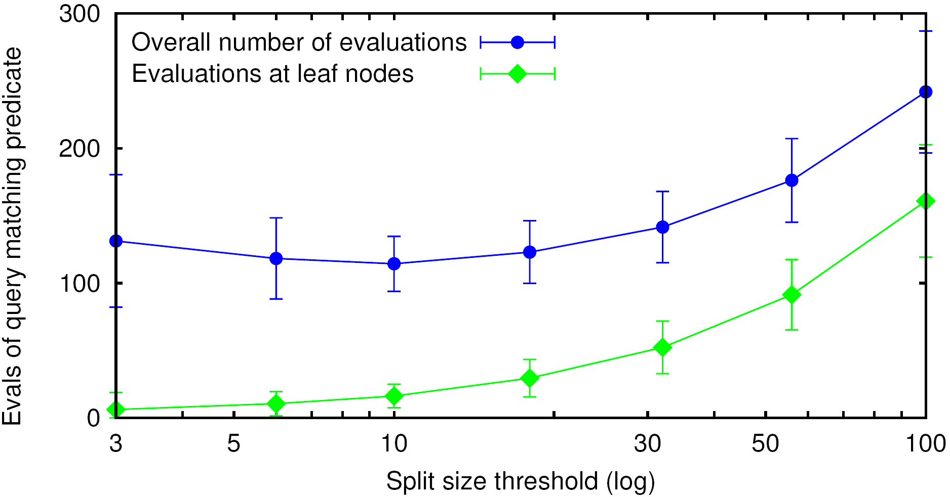
Results on Searching (2)

Slide 26
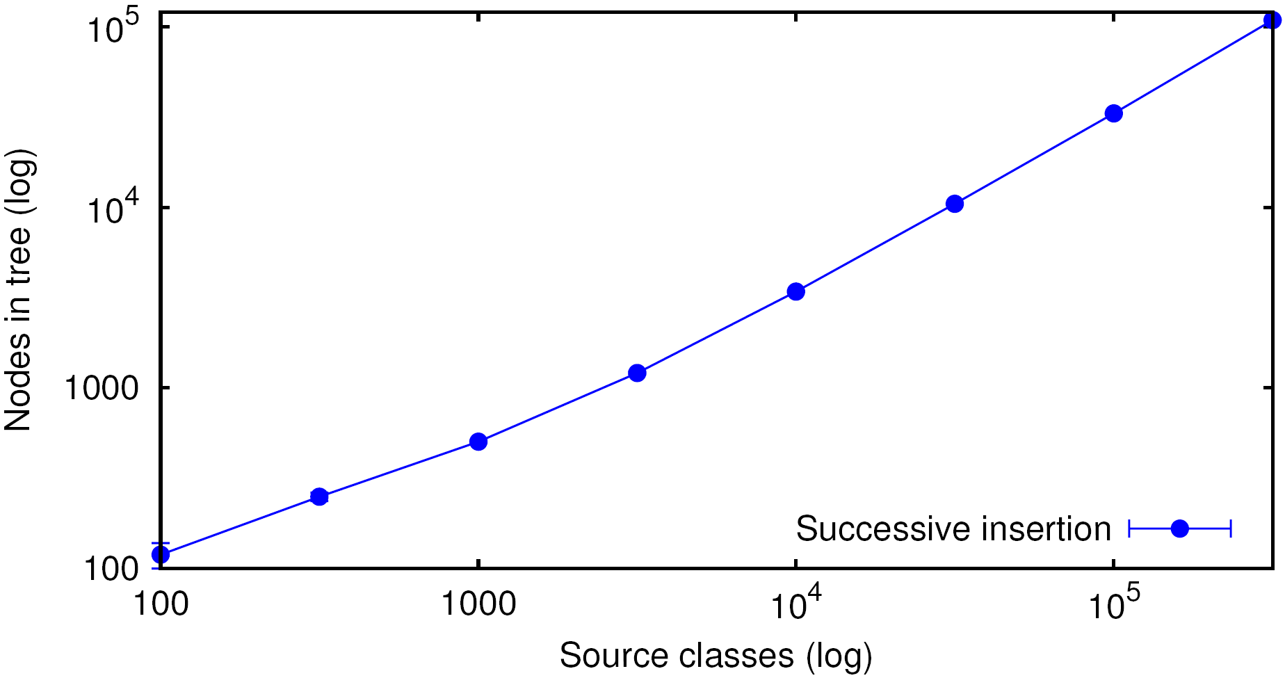
Results on Tree Size

Slide 27
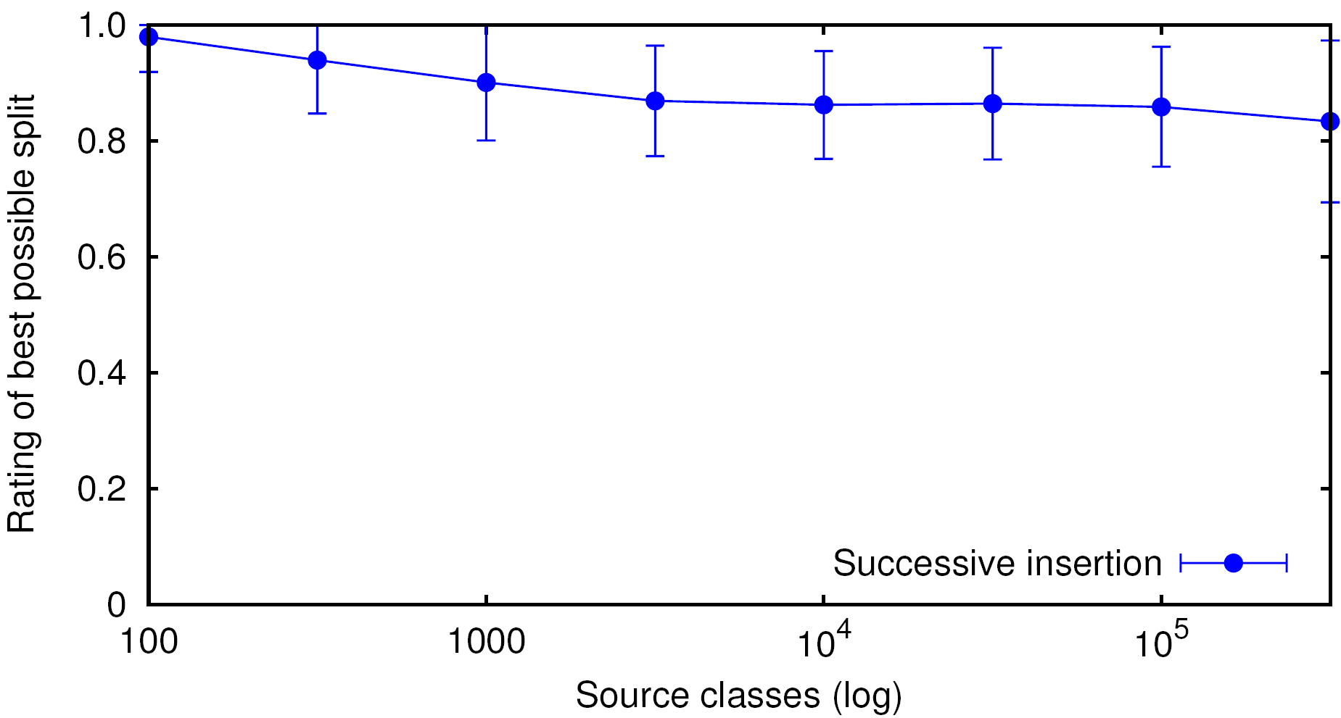
Results on Split Rating
Notes:
Rating of best possible split depending on number of indexed source classes

Slide 28
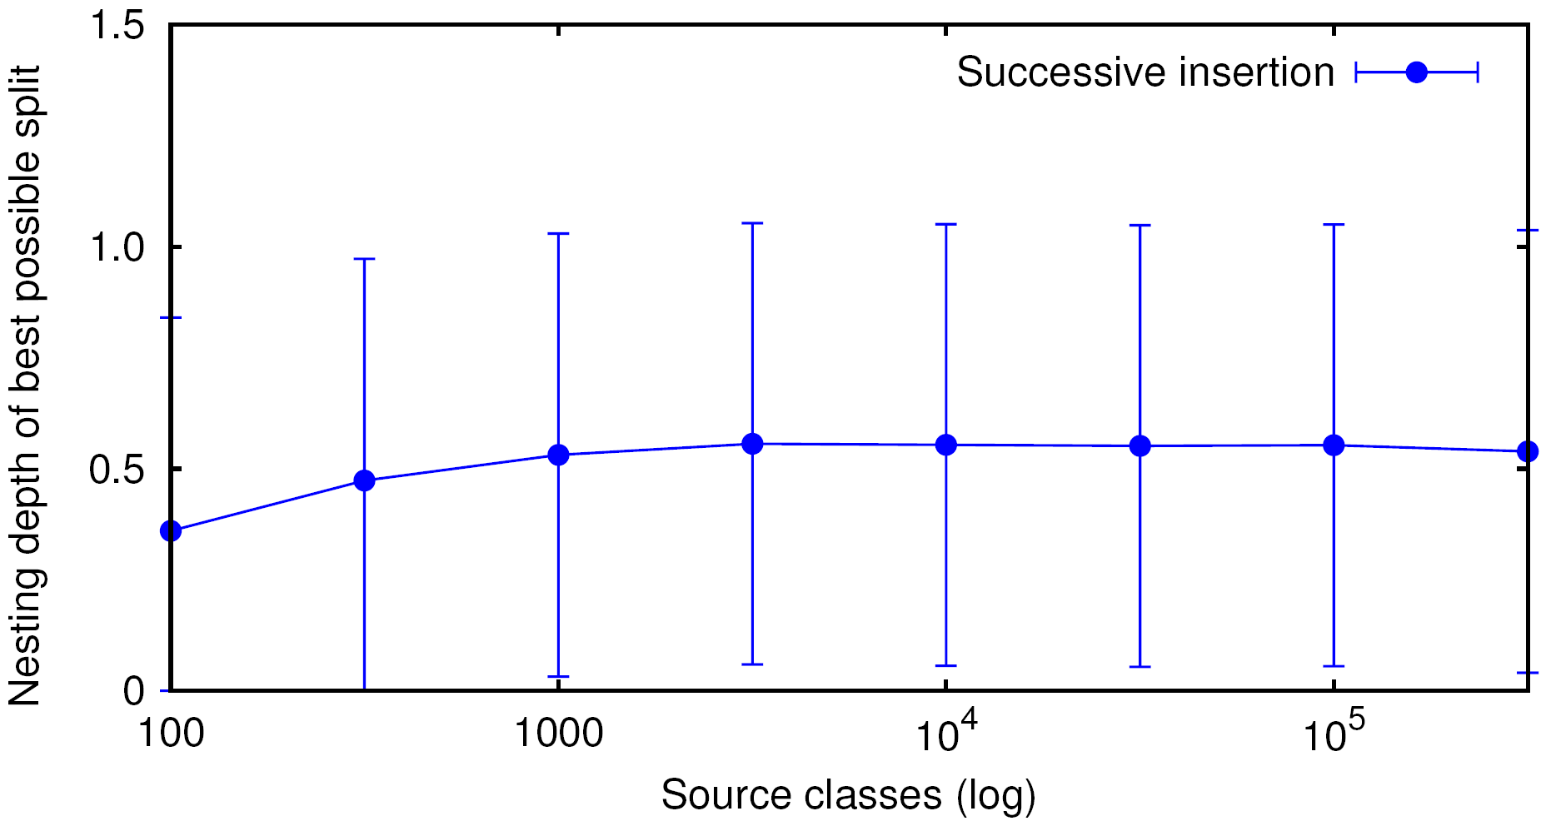
Results on Nesting Depth

